Slide 1
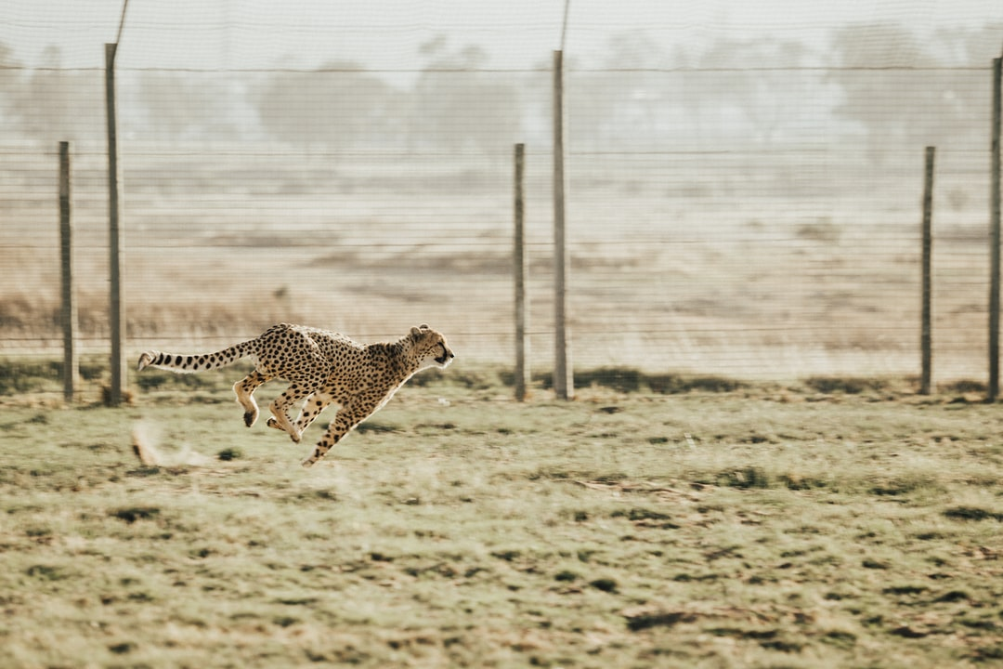
cheetah

Slide 2
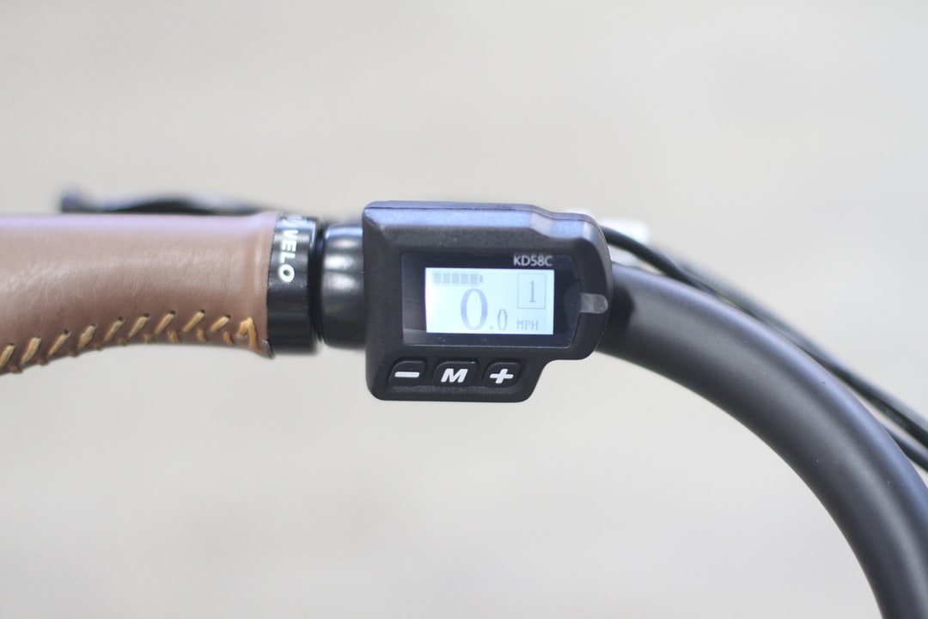
fast
Cheetahs are fast animals reaches speed of 80 mph

Slide 3

eat
They eat gazelles

Slide 4
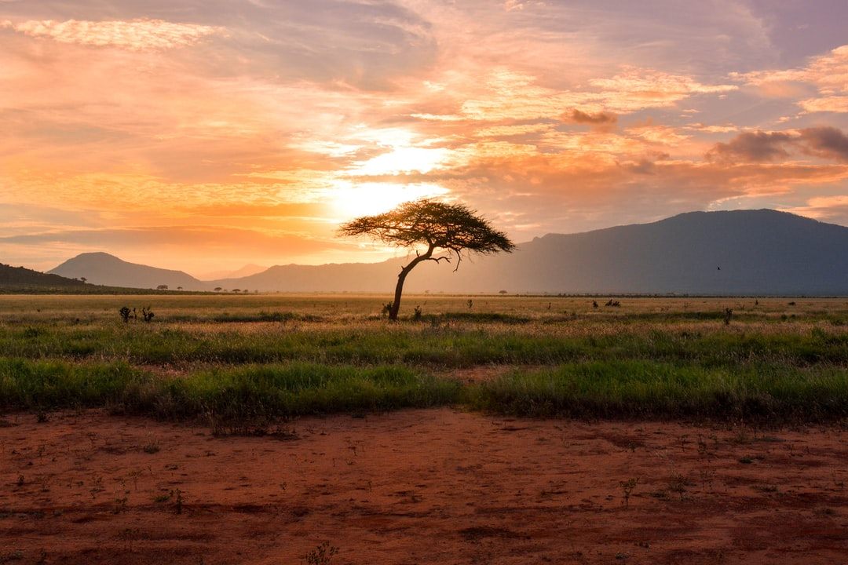
They live in a savanna
Savanna grasslands

